Slide 1
Software Engineering
Week 07 Lecture 01

Slide 2
RECAP

Slide 3
Class-based modeling
Association: the type of relationship between classes.
Exactly one (1)
Zero to Many (0 … *)
Zero or one (0 … 1)
One to Many (1 … *)
Many to Many (* … *)
Association is a has-a relationship

Slide 4
Class-based modeling [contd..]
Dependency:
Car
-color: string
+moves()
Engine
-horsepower: int
+starts()

Slide 5
Class-based modeling [contd..]
Generalization:
Person
-name: string
+walks()
Student
-rollNo: int
+studies()
Is-a

Slide 6
Class-based modeling [contd..]
Aggregation:
Car
-color: string
+moves()
Engine
-horsepower: int
+starts()

Slide 7
Class-based modeling [contd..]
Composition:
Book
-name: string
Pages
-color: string

Slide 8
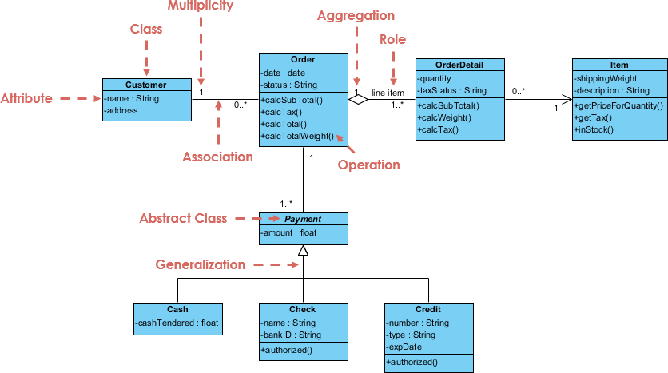
Class-based modeling [contd..]
Association
Example:
Online Shopping
ShoppingCart
-noOfItems : int
Notes:
Entries: Customer, Order, Item, Payment, Shopping Cart

Slide 9
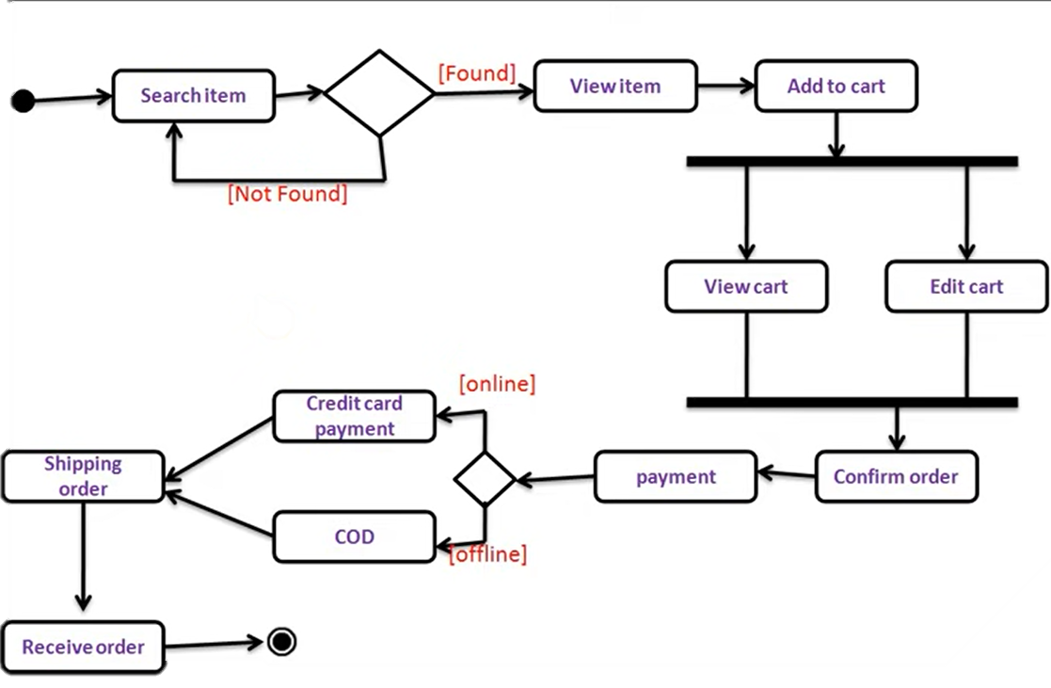
Scenario-based modeling
Activity Diagram
Example:

Slide 10
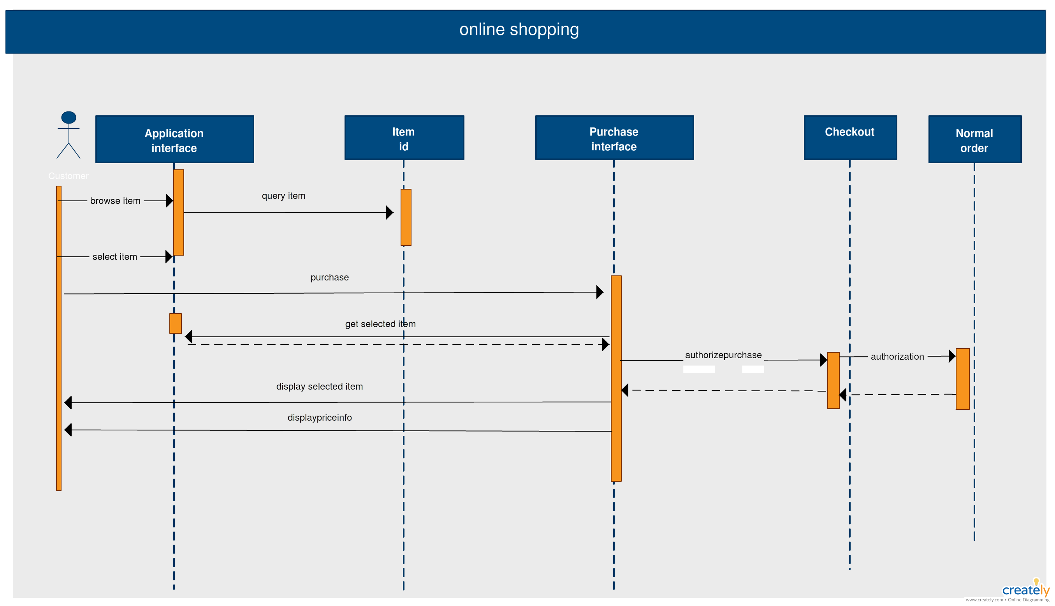
Behavioral modeling [contd..]
Components of a sequence diagram
Notes:
Behavioral Modeling: Sequence Diagram

Slide 11
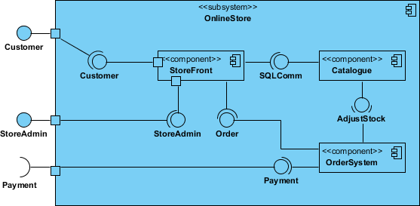
Flow-oriented Modeling
Repository
Request Item
Notes:
Component Diagram

Slide 12
Data Flow Diagram (DFD)
Graphically shows the flow of data between different components or modules.
The system or process is represented by a collection of interconnected modules, called processes.

Slide 13
Data Flow Diagram (DFD) [contd..]
Source
Sink
Components of DFD:
External entity: an outside system that sends or receives data, communicating with the system being diagrammed.
Process: any process that changes the data, producing an output
Data store: files or repositories that hold information for later use, such as a database table
Notes:
1- destination and source. Might be outside organization, person, computer system etc. They are also known as terminators, sources and sinks or actors.

Slide 14
Data Flow Diagram (DFD) [contd..]
Components of DFD:
Data flow: the route that data takes between the external entities, processes and data stores.
External Entity Process Data Store Data Flow

Slide 15
Data Flow Diagram (DFD) [contd..]
Rules of DFD:
Each process should have at least one input and an output.
Each data store should have at least one data flow in and one data flow out.
Data stored in a system must go through a process.
All processes in a DFD go to another process or a data store.
Data can’t flow from external entity to external entity or data store.

Slide 16
Data Flow Diagram (DFD) [contd..]
Levels of DFD:
A data flow diagram can have many levels depending on the details of the system.
DFD levels are numbered 0,1,2 and so on.
DFD level 0 (also called Context Diagram) is the basic high-level view of the whole system.

Slide 17
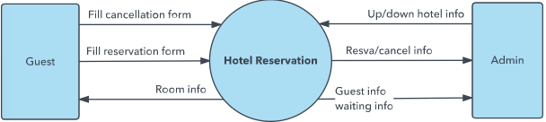
Data Flow Diagram (DFD) [contd..]
Levels of DFD:
Level 0 diagram of Hotel Reservation system.

Slide 18
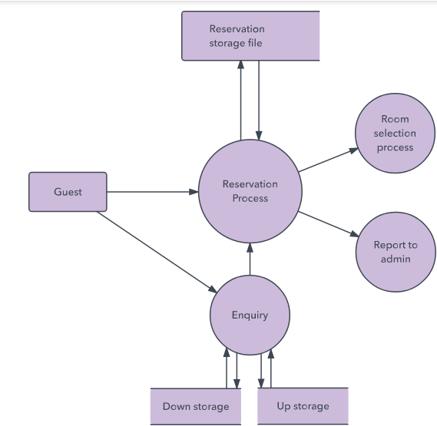
Data Flow Diagram (DFD) [contd..]
Levels of DFD:
DFD level 1 is a more detailed view of Context Level Diagram, providing the functionalities of processes.

Slide 19
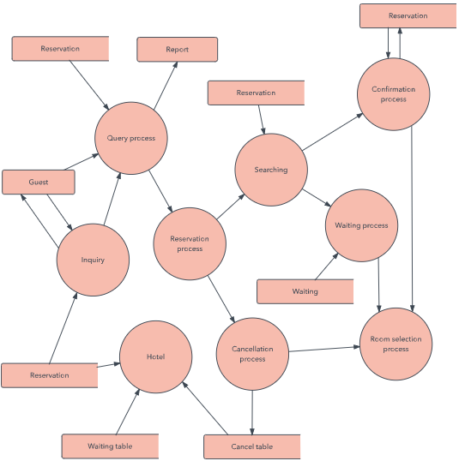
Data Flow Diagram (DFD) [contd..]
Levels of DFD:
DFD level 2 is the more detailed view of processes of DFD

Slide 20
Entity-Relation Diagram
An Entity-Relationship Diagram (ERD) is a graphical representation of entities and their relationships to each other in a system.

Slide 21
Entity-Relation Diagram
Steps for creating ERD
1- Identify the entities
2- Define the relationships
3- Assign attributes to the entities
4- Find Identifier
5- Draw the ERD

Slide 22
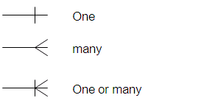
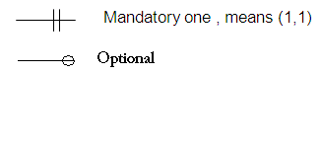
Entity-Relation Diagram [contd..]
Entity: object having
physical existence
Attributes: properties
Identifier: unique attribute
Connectivity: association
Student____
Student____
Student_ID Student_Name Home_Address, Phone_Number Major
Student____
*Student_ID Student_Name Home_Address, Phone_Number Major

Slide 23
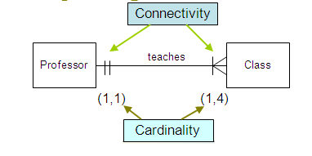
Entity-Relation Diagram [contd..]

Slide 24
Entity-Relation Diagram [contd..]
A system for managing student course registration would need data about courses, instructors, course sections, course seats, and students; these are entities. The course registration management process might require course name, number, and credit hours; these are attributes. The course registration management process might also require instructor name, number, and department; these are also attributes. In ERD notation, the entity name appears in the top of the box. The attributes are listed in the box below the name. The lines connecting the boxes convey information about the relationships between the data.

Slide 25
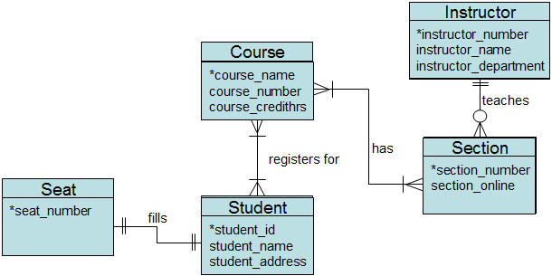
Entity-Relation Diagram [contd..]
Notes:
A system for managing student course registration would need data about courses, instructors, course sections, course seats, and students; these are entities. The course registration management process might require course name, number, and credit hours; these are attributes. The course registration management process might also require instructor name, number, and department; these are also attributes. In ERD notation, the entity name appears in the top of the box. The attributes are listed in the box below the name. The lines connecting the boxes convey information about the relationships between the data.

